Slide 1
RDF Schema, RDFa
Pedro Szekely
University of Southern California/ISI
slide by Pedro Szekely

Slide 2
Semantic Web Layer Cake
slide by Pedro Szekely

Slide 3
Components from Last Lecture
Unicode
Standard for encoding international characters
URI
String of standardized form to uniquely identify resources
URL: http://www.example.org
URN: urn:isbn:0-123-45678-9
IRI: international variant of URI (with unicode)
XML
So that we have a common syntax for Semantic Web
XML schema
Define types, e.g., USAddress, for a particular set of XML documents, e.g., Invoices
slide by Wensheng Wu

Slide 4
and …
Namespace
So that we can have different markup vocabularies in one document
RDF (resource description framework)
Was used to represent metadata of Web resources
E.g., title, author, modification date
Generally, a graph representation of any resources
Triple: resource-property-value or subject-predicate-object
Anyone can define vocabulary of terms
slide by Wensheng Wu

Slide 5
RDF Recap
FOAF (friend of a friend)
Terms for describing people and Social Web
Classes, e.g., Person, OnlineAccount
Properties, e.g., name, homepage, accountname
Using FOAF
RDF predefine some classes (e.g., rdf:Property) and properties (e.g., rdf:type)
Ex:DavidSmith
foaf:givenName
David
Ex:DavidSmith
rdf:type
foaf:Person
slide by Wensheng Wu

Slide 6
RDF Serialization: RDF/XML
Ex:DavidSmith
foaf:givenName
David
<rdf:RDF xmlns:rdf=“http://www.w3.org/1999/02/22-rdf-syntax-ns#”
xmlns:Ex=http://www.example.org/person#>
<rdf:Description rdf:about=http://www.example.org/person#DavidSmith>
<foaf:givenName>David</foaf:givenName>
</rdf:Description>
</rdf:RDF>
slide by Wensheng Wu
Notes:
http://www.w3.org/1999/02/22-rdf-syntax-ns#Description
description

Slide 7
RDF Serialization: Turtle
Terse RDF triple language
RDF in compact text format
Ex:DavidSmith
foaf:givenName
David
@prefix Ex: <http://www.example.org/person#>
Ex:DavidSmith foaf:givenName “David”.
slide by Wensheng Wu
Notes:
http://www.w3.org/1999/02/22-rdf-syntax-ns#Description
description

Slide 8
Limited Vocabulary in RDF
RDF vocabulary
Classes: rdf:Property, rdf:XMLLiteral, rdf:HTML, rdf:langString (language-tagged string values)
Properties, e.g., rdf:type
allow you to state “instance-of” relationship
Use rdf:type to explicitly define new properties
Ex:title rdf:type rdf:Property
or simply:
Ex:title a rdf:Property
(‘a’ is a syntactic shortcut for rdf:type)
slide by Wensheng Wu

Slide 9
RDF Schema or RDFS
Add new vocabulary for describing
Classes
e.g., rdfs:Class
Taxonomy of classes
e.g., rdfs:subClassOf
Taxonomy of properties
e.g., rdfs:subPropertyOf
Domain and range of properties
rdfs:domain, rdfs:range
Class
?
?
Class
Instance
New properties
slide by Wensheng Wu

Slide 10
@prefix : <http://www.example.org/sample.rdfs#> .
@prefix rdf: <http://www.w3.org/1999/02/22-rdf-syntax-ns#> .
@prefix rdfs: <http://www.w3.org/2000/01/rdf-schema#>.
:Dog rdfs:subClassOf :Animal.
:Person rdfs:subClassOf :Animal.
:hasChild rdfs:range :Animal;
rdfs:domain :Animal.
:hasSon rdfs:subPropertyOf
:hasChild.
:Max a :Dog.
:Abel a :Person.
:Adam a :Person;
:hasSon :Abel.
Concept/property
hierarchy
?
hasChild
Animal
?
?
subClassOf
subClassOf
hasSon
Dog
Person
?
?
?
Max
Abel
Adam
Instances
hasSon
slide by Wensheng Wu

Slide 11
RDFS: New Predefined Classes
Major ones:
rdfs:Resource – a top-level class
rdfs:Class – a class of all classes
rdfs:Literal – a class of literals, e.g., strings and integers
A literal may have 3 components: “David”^^xsd:string@en
Lexical form: “David”
Data type IRI: ^^xsd:string
Language tag (for string only): @en
RDFS reuses XML schema built-in data types
xsd:string, xsd:boolean, xsd:decimal, xsd:integer, etc
Note rdf:XMLLiteral is a subclass of rdfs:Literal
XMLLIteral: XML fragment as a literal
slide by Wensheng Wu

Slide 12
More …
rdfs:DataType – a class of all data types, including
Built-in data types in XSD
rdf:HTML
rdf:XMLLiteral
Notes:
Every instance of rdfs:DataType (e.g., rdf:XMLLiteral) is a subclass of rdf:Literal
rdfs:DataType is a subclass of rdfs:Class, since it contains a set of classes (data types)
slide by Wensheng Wu

Slide 13
Summary of Classes in RDF(S)
Class | Represent | SubClassOf | InstanceOf
rdfs:Resource | All resources | rdfs:Resource | rdfs:Class
rdfs:Class | All classes | rdfs:Resource | rdfs:Class
rdfs:Literal | Literal values | rdfs:Resource | rdfs:Class
rdfs:DataType | Data types | rdfs:Class | rdfs:Class
rdf:XMLLiteral/ rdf:langString/ rds:HTML | XML/ language-tagged/ HTML literal values | rdfs:Literal | rdfs:DataType
rdf:Property | All properties | rdfs:Resource | rdfs:Class
… | … | … | …
Note: Properties are resources too
slide by Wensheng Wu

Slide 14
Summary in an RDF Graph
Every class is a
subclass of Resource
Every class is a class
rdfs:Resource
rdfs:Class
rdfs:Literal
Every class is a
resource
DataType is a subclass of Class
rdfs:DataType
slide by Pedro Szekely
Notes:
Every class is a subclass and an instance of resource class. Every class is instance of class.
Datatype is subclass of class.

Slide 15
Adding rdf:XMLLiteral (1)
rdfs:Resource
rdfs:Class
rdfs:Literal
rdf:XMLLiteral
rdfs:DataType
slide by Pedro Szekely
Notes:
Every class is a subclass and an instance of resource class. Every class is instance of class.
Datatype is subclass of class.

Slide 16
Adding rdf:XMLLiteral (2)
rdfs:Resource
rdfs:Class
rdfs:Literal
rdf:XMLLiteral
rdfs:DataType
slide by Pedro Szekely
Notes:
Every class is a subclass and an instance of resource class. Every class is instance of class.
Datatype is subclass of class.

Slide 17
Adding rdfs:Property (1)
rdfs:Resource
rdfs:Class
rdfs:Literal
rdf:Property
rdfs:DataType
slide by Pedro Szekely
Notes:
Every class is a subclass and an instance of resource class. Every class is instance of class.
Datatype is subclass of class.

Slide 18
Adding rdfs:Property (2)
rdfs:Resource
rdfs:Class
rdfs:Literal
rdf:Property
rdfs:DataType
slide by Pedro Szekely
Notes:
Every class is a subclass and an instance of resource class. Every class is instance of class.
Datatype is subclass of class.

Slide 19
Summary of Properties in RDF(S)
Defined in RDF
rdf:type, rdf:value
Defined in RDFS
rdfs:domain, rdfs:range
rdfs:subClassOf, rdfs:subPropertyOf
rdfs:label (human-readable name of resource), rdfs:comment, rdfs:seeAlso, rdfs:definedBy
All theses are instances of rdf:Property
slide by Wensheng Wu

Slide 20
Summary of Properties in RDF(S)
Property | Relates | Domain (rdfs:domain) | Range (rdfs:range)
rdfs:domain | Restricts subjects | ? | ?
rdfs:range | Restricts objects | ? | ?
rdfs:subPropertyOf | Subproperty | ? | ?
rdfs:subClassOf | Subclass of | ? | ?
rdf:type | Instance of | ? | ?
rdfs:range
Animal
hasChild
rdfs:domain
rdfs:subPropertyOf
subClassOf
subClassOf
hasSon
Dog
Person
rdf:type
?
?
Max
Abel
Adam
hasSon

Slide 21
Summary of Properties in RDF(S)
Property | Relates | Domain (rdfs:domain) | Range (rdfs:range)
rdfs:domain | Restricts subjects | rdfs:Property | rdfs:Class
rdfs:range | Restricts objects | rdfs:Property | rdfs:Class
rdfs:subPropertyOf | Subproperty | rdfs:Property | rdfs:Property
rdfs:subClassOf | Subclass of | rdfs:Class | rdfs:Class
rdf:type | Instance of | rdfs:Resource | rdfs:Class
rdfs:range
Animal
hasChild
rdfs:domain
rdfs:subPropertyOf
subClassOf
subClassOf
hasSon
Dog
Person
rdf:type
?
?
Max
Abel
Adam
hasSon
slide by Wensheng Wu

Slide 22
RDFa
RDF in Attributes

Slide 23
RDFa: Resource Description Framework – in – attributes
Plain XHTML
<p>
In his latest book
<cite>Wikinomics</cite>,
<span>Don Tapscott</span>
explains deep changes in technology,
demographics and business.
The book is due to be published in
<span>October 2006</span>.
</p>
Browser
shows
In his latest book Wikinomics, Don Tapscott explains deep changes in technology, demographics and business. The book is due to be published in October 2006.
slide by Pedro Szekely

Slide 24
RDFa: Namespaces
namespace declaration
<p xmlns:dc="http://purl.org/dc/elements/1.1/">
In his latest book
<cite>Wikinomics</cite>,
<span>Don Tapscott</span>
explains deep changes in technology,
demographics and business.
The book is due to be published in
<span>October 2006</span>.
</p>
Browser
shows
In his latest book Wikinomics, Don Tapscott explains deep changes in technology, demographics and business. The book is due to be published in October 2006.
slide by Pedro Szekely

Slide 25
RDFa: Resources
Resource declaration
<p xmlns:dc="http://purl.org/dc/elements/1.1/”
about="http://www.example.com/books/wikinomics">
In his latest book
<cite>Wikinomics</cite>,
<span>Don Tapscott</span>
explains deep changes in technology,
demographics and business.
The book is due to be published in
<span>October 2006</span>.
</p>
Browser
shows
In his latest book Wikinomics, Don Tapscott explains deep changes in technology, demographics and business. The book is due to be published in October 2006.
slide by Pedro Szekely

Slide 26
RDFa: Property
property declaration
<p xmlns:dc="http://purl.org/dc/elements/1.1/”
about="http://www.example.com/books/wikinomics">
In his latest book
<cite property="dc:title">Wikinomics</cite>,
<span>Don Tapscott</span>
explains deep changes in technology,
demographics and business.
The book is due to be published in
<span>October 2006</span>.
</p>
Browser
shows
In his latest book Wikinomics, Don Tapscott explains deep changes in technology, demographics and business. The book is due to be published in October 2006.
slide by Pedro Szekely

Slide 27
RDFa: Property
<p xmlns:dc="http://purl.org/dc/elements/1.1/”
about="http://www.example.com/books/wikinomics">
In his latest book
<cite property="dc:title">Wikinomics</cite>,
<span>Don Tapscott</span>
explains deep changes in technology,
demographics and business.
The book is due to be published in
<span>October 2006</span>.
</p>
RDF-enabled computer sees:
http://www.example.com/books/wikinomics
dc:title
“Wikinomics”
slide by Pedro Szekely

Slide 28
What’s the Difference?
<p xmlns:dc="http://purl.org/dc/elements/1.1/”
about="http://www.example.com/books/wikinomics">
In his latest book
<cite property="dc:title">Wikinomics</cite>,
<span>Don Tapscott</span>
…
</p>
<p xmlns:dc="http://purl.org/dc/elements/1.1/”
about="http://www.example.com/books/wikinomics">
In his latest book
<cite property=“title">Wikinomics</cite>,
<span>Don Tapscott</span>
…
</p>
slide by Pedro Szekely

Slide 29
What’s the Difference?
<p xmlns:dc="http://purl.org/dc/elements/1.1/”
about="http://www.example.com/books/wikinomics">
In his latest book
<cite property="dc:title">Wikinomics</cite>,
<span>Don Tapscott</span>
…
</p>
<p xmlns:dc="http://purl.org/dc/elements/1.1/”
about="http://www.example.com/books/wikinomics">
In his latest book
<cite property=“title">Wikinomics</cite>,
<span>Don Tapscott</span>
…
</p>
what does title mean?
slide by Pedro Szekely

Slide 30
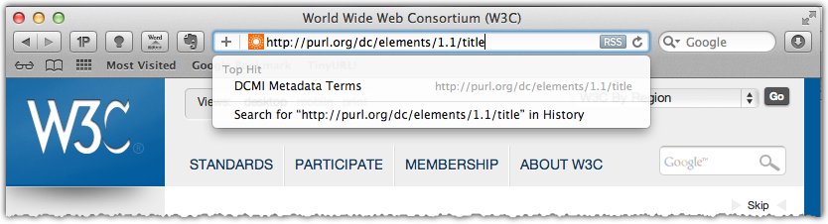
I Can Look Up the Meaning on the Web
<p xmlns:dc="http://purl.org/dc/elements/1.1/”
about="http://www.example.com/books/wikinomics">
In his latest book
<cite property="dc:title">Wikinomics</cite>,
<span>Don Tapscott</span>
…
</p>
slide by Pedro Szekely

Slide 31
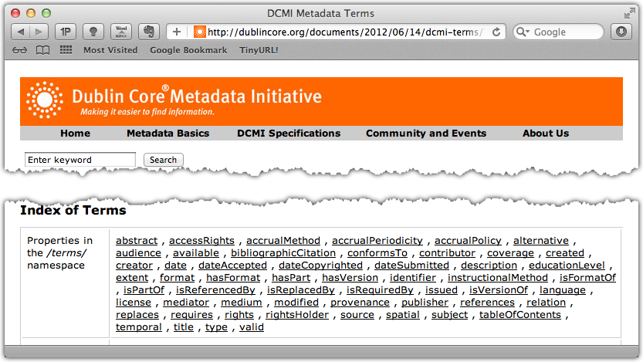
I Can Look Up the Meaning on the Web
slide by Pedro Szekely

Slide 32
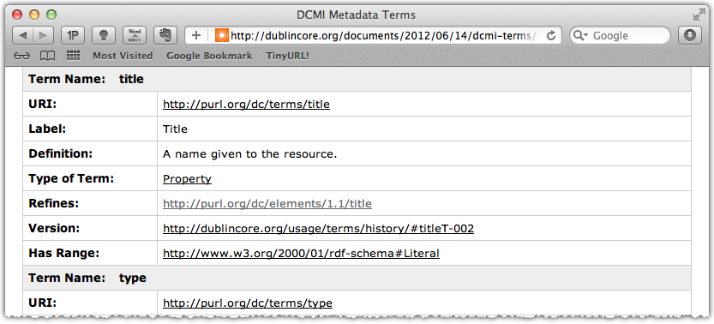
I Can Look Up the Meaning on the Web
Humans can look up what it means
slide by Pedro Szekely

Slide 33
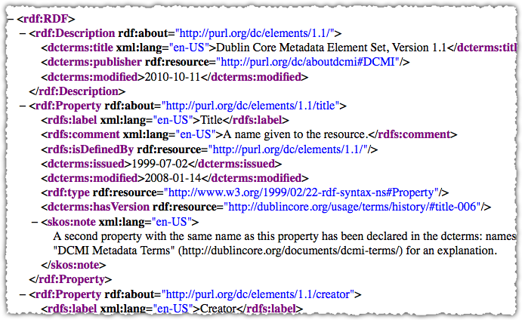
Computers Can Look It Up Too
slide by Pedro Szekely
Notes:
Rdf:description rdf:id=“xxx”

Slide 34
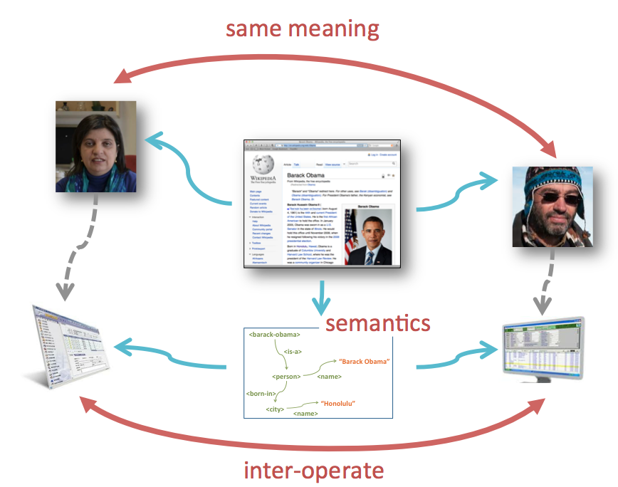
What’s the Big Deal?
Claudia, Pedro & the computers can all agree on the meaning of
dc:title
slide by Pedro Szekely

Slide 35
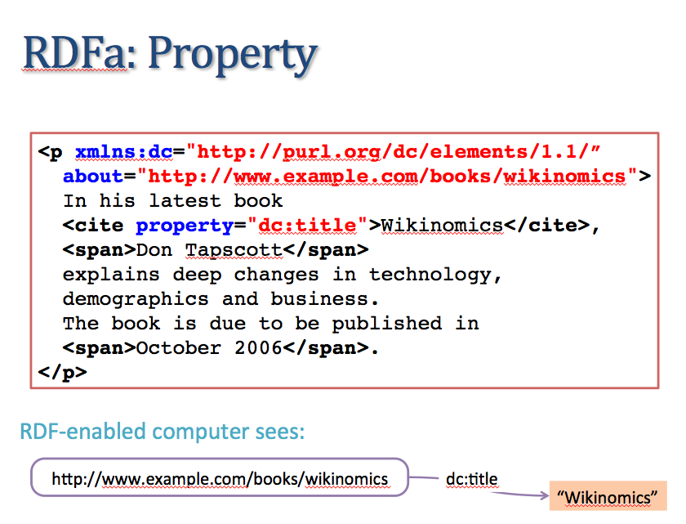
Where Were We?
slide by Pedro Szekely

Slide 36
What’s Wrong Here?
<p xmlns:dc="http://purl.org/dc/elements/1.1/”
about="http://www.example.com/books/wikinomics">
In his latest book
<cite property="dc:title">Wikinomics</cite>,
<span property="dc:creator">Don Tapscott</span>
explains deep changes in technology,
demographics and business.
The book is due to be published in
<span property="dc:date”>October 2006</span>.
</p>
Not a computer understandable date
e.g., an xsd:date
slide by Pedro Szekely

Slide 37
RDFa: Content Attribute
<p xmlns:dc="http://purl.org/dc/elements/1.1/”
about="http://www.example.com/books/wikinomics">
In his latest book
<cite property="dc:title">Wikinomics</cite>,
<span property="dc:creator">Don Tapscott</span>
explains deep changes in technology,
demographics and business.
The book is due to be published in
<span property="dc:date”
content="2006-10-01”
datatype=“xsd:date”>October 2006</span>.
</p>
slide by Pedro Szekely

Slide 38
RDFa: Resource Description Framework – in – attributes
XHTML
+
RDFa
<p xmlns:dc="http://purl.org/dc/elements/1.1/”
about="http://www.example.com/books/wikinomics">
In his latest book
<cite property="dc:title">Wikinomics</cite>,
<span property="dc:creator">Don Tapscott</span>
explains deep changes in technology,
demographics and business.
The book is due to be published in
<span property="dc:date”
content="2006-10-01”
datatype=“xsd:date”>October 2006</span>.
</p>
Extracted
RDF
@prefix dc: http://purl.org/dc/elements/1.1/ .
<http://www.example.com/books/wikinomics>
dc:title ”Wikinomics”@en ;
dc:creator ”Don Tapscott”@en ;
dc:date "2006-10-01”^^xsd:date .
Browser
shows
In his latest book Wikinomics, Don Tapscott explains deep changes in technology, demographics and business. The book is due to be published in October 2006.
slide by Pedro Szekely

Slide 39
More RDFa

Slide 40
RDFa: vocab and typeof
Define default vocabulary for an HTML element
<div vocab="http://xmlns.com/foaf/0.1/">
<ul>
<li typeof="Person">
<a href="http://example.com/bob/">Bob</a>
</li>
<li typeof="Person">
<a href="http://example.com/eve/">Eve</a>
</li>
</ul>
</div>
Nested elements don’t need
vocabulary URI
slide by Pedro Szekely

Slide 41
RDFa: property and href
<div vocab="http://xmlns.com/foaf/0.1/">
<ul>
<li typeof="Person">
<a property=“homepage” href="http://example.com/bob/">Bob</a>
</li>
<li typeof="Person">
<a property=“homepage” href="http://example.com/eve/">Eve</a>
</li>
</ul>
</div>
When href is present, it supplies the value for the property
slide by Pedro Szekely

Slide 42
RDFa: Using Extra Span Tags
<div vocab="http://xmlns.com/foaf/0.1/">
<ul>
<li typeof="Person">
<a property="homepage" href="http://example.com/bob/">
<span property="name">Bob</span></a>
</li>
<li typeof="Person">
<a property="homepage" href="http://example.com/eve/">
<span property="name">Eve</span></a>
</li>
</ul>
</div>
Need a span tag to contain the
property=“name” tag of my friends
slide by Pedro Szekely

Slide 43
Putting It All Together
<div vocab="http://xmlns.com/foaf/0.1/" typeof="Person”>
<p>
<span property="name">Alice Birpemswick</span>,
Email: <a property="mbox”
href="mailto:alice@example.com”>alice@example.com</a>,
Phone: <a property="phone"
href="tel:+1-617-555-7332">+1 617.555.7332</a>
</p>
<ul>
<li property="knows" typeof="Person">
<a property="homepage" href="http://example.com/bob/">
<span property="name">Bob</span></a>
</li>
<li property="knows" typeof="Person">
<a property="homepage" href="http://example.com/eve/">
<span property="name">Eve</span></a>
</li>
</ul>
</div>
RDF properties: e.g., phone
RDF objects: e.g., Eve
slide by Pedro Szekely

Slide 44
Resulting RDF
<div vocab="http://xmlns.com/foaf/0.1/" typeof="Person”>
<p>
<span property="name">Alice Birpemswick</span>,
Email: <a property="mbox”
href="mailto:alice@example.com”>alice@example.com</a>,
Phone: <a property="phone"
href="tel:+1-617-555-7332">+1 617.555.7332</a>
</p>
<ul>
<li property="knows" typeof="Person">
<a property="homepage href="http://example.com/bob/">
<span property="name">Bob</span></a>
</li>
<li property="knows" typeof="Person">
<a property="homepage" href="http://example.com/eve/">
<span property="name">Eve</span></a>
</li>
</ul>
</div>
[ a foaf:Person ;
foaf:name “Alice” ;
foaf:mbox <mailto:alice@example.com> ;
foaf:phone <tel:+1-617-555-7332> ;
foaf:knows [
a foaf:Person ;
foaf:homepage <http://example.com/bob/> ;
foaf:name “Bob”
] ;
foaf:knows [
a foaf:Person ;
foaf:homepage <http://example.com/eve/> ;
foaf:name “Eve”
] ;
]
slide by Pedro Szekely

Slide 45

Facebook OpenGraph
RDF used by the “Like” button
<html>
<head prefix="og: http://ogp.me/ns#" >
...
<meta property="og:title" content="The Trouble with Bob" />
<meta property="og:type" content="text" />
<meta property="og:image" content="http://example.com/alice/ugly.jpg" />
...
</head>
<body>
...
</body>
</html>
slide by Pedro Szekely

Slide 46
RDFa: rel Attribute
<div vocab="http://xmlns.com/foaf/0.1/" resource="#me">
<ul>
<li property="knows" resource="http://example.com/bob/#me" typeof="Person">
<a property="homepage" href="http://example.com/bob/"><span property="name">Bob</span></a>
</li>
<li property="knows" resource="http://example.com/eve/#me" typeof="Person">
<a property="homepage" href="http://example.com/eve/"><span property="name">Eve</span></a>
</li>
</ul>
</div>
rel looks down for values
<div vocab="http://xmlns.com/foaf/0.1/" resource="#me">
<ul rel="knows">
<li resource="http://example.com/bob/#me" typeof="Person">
<a property="homepage" href="http://example.com/bob/"><span property="name">Bob</span></a>
</li>
<li resource="http://example.com/eve/#me" typeof="Person">
<a property="homepage" href="http://example.com/eve/"><span property="name">Eve</span></a>
</li>
</ul>
</div>
slide by Pedro Szekely

Slide 47
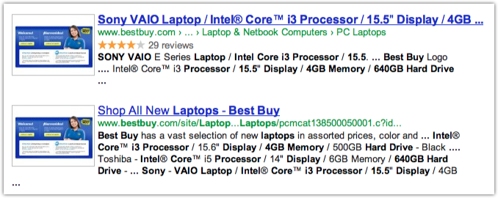
Benefits of RDFa
Navigation bar (from RDFa?)
Reviews from RDFa
Google understands the page content
slide by Pedro Szekely

Slide 48

http://www.data-vocabulary.org/Review-aggregate/
<div class="rating"
typeof="v:Review-aggregate"
about="#review_3505047">
<span
property="v:itemreviewed"
content=""></span>
<span rel="v:rating">
<span typeof="v:Rating">
<img src="http://images.bestbuy.com/BestBuy_US/images…/>
<span
property="v:rating"
datatype="xsd:string”>4.0</span> of
<span property="v:best">5</span>
<span
property="v:count"
datatype="xsd:string"
content="30">
</span>
(<a class="customer-review"
href="#tabbed-customerreviews">30 reviews</a>)
</span>
</span>
</div>
slide by Pedro Szekely
Notes:
http://www.data-vocabulary.org/Review-aggregate/

Slide 49

http://searchnewscentral.com/20110207129/Technical/rdfa-the-inside-story-from-best-buy.html
slide by Pedro Szekely

Slide 50
Who Uses RDFa?
RDFa is the fastest growing data markup format on the Web, and is used on more than 430 million web pages.
It accounts for roughly 3.6% of the all of the Web pages on the Internet.
How much did RDFa grow last year? 510% (2010)
… will show even stronger growth as people start to realize the search engine advantage that RDFa gives web content publishers.
http://rdfa.info/2011/01/26/rdfa-grows/
slide by Pedro Szekely

Slide 51
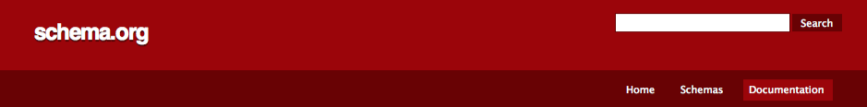

“You use the schema.org vocabulary, along with the microdata format, to add information to your HTML content.”
non-RDFa microdata even though
RDF vocabulary was defined
<div
itemscope
itemtype="http://schema.org/Movie">
<h1 itemprop="name">Avatar</h1>
<span>Director:
<span itemprop="director">James Cameron</span>
(born August 16, 1954)
</span>
<span itemprop="genre">Science fiction</span>
<a href="../movies/avatar-theatrical-trailer.html"
itemprop="trailer">Trailer</a>
</div>
slide by Pedro Szekely
http://schema.org/

Slide 52
Backup slides

Slide 53
RDF Schema

Slide 54
RDFS Vocabulary
xmlns:rdfs="http://www.w3.org/2000/01/rdf-schema#"
Classes
Properties
Utility Properties
rdfs:Resource
rdfs:Class
rdfs:Literal
rdfs:Datatype
rdf:XMLLiteral
rdf:Property
rdfs:range
rdfs:domain
rdf:type
rdfs:subClassOf
rdfs:subPropertyOf
rdfs:label
rdfs:comment
rdfs:seeAlso
rdfs:isDefinedBy
rdf:value
slide by Pedro Szekely
Notes:
rdf:description included too?
Attribute rdf:about=“…” where defined in standard
Rdf ones:

Slide 55
Notation and Conventions
Things that are Classes
subclass
relationship
Class
instance
relationship
Instance
“Literal”
Class
Things that are literals
Things that are instances
slide by Pedro Szekely
Notes:
Instance of relationship ? No of

Slide 56
Meaning of Subclass
instances of A
A
B
instances of B
slide by Pedro Szekely

Slide 57
Meaning of Subclass
A
B
if B is a subclass of A,
the instances of B are a subset of the instances of A
slide by Pedro Szekely

Slide 58
rdfs:Resource
All things described by RDF are called resources, and are instances of the class rdfs:Resource
This is similar to Object class in Java class hierarchy
Implications
Every class/property is a resource too
Properties can themselves have properties
rdfs:Resource
rdfs:Class
rdfs:Literal
slide by Pedro Szekely

Slide 59
rdfs:Class
the class of resources that are RDF classes
rdfs:Resource
rdfs:Class is a class
rdfs:Class
rdfs:Class is an instance of rdfs:Class
In fact, every class, including rdfs:Resource,
is an instance of rdfs:Class
slide by Pedro Szekely
Notes:
Resoruce ➔ class

Slide 60
rdfs:Literal, rdfs:Datatype
class rdfs:Literal is the class of literal values such as strings and integers
typed literals
plain literals
class rdfs:Datatype is the class of typed literals
there is no class for plain literals?
slide by Pedro Szekely
Notes:
No class ? For?
Data type is subclass of literals?

Slide 61
The Story So Far
Every class is
subclass of Resource
Every class is an
instance of Class
rdfs:Resource
rdfs:Class
rdfs:Literal
Every class is an instance of Resource
rdfs:Datatype
slide by Pedro Szekely
Notes:
Every class is a subclass and an instance of resource class. Every class is instance of class.
Datatype is subclass of class.

Slide 62
rdfs:Property
the class of resources that are RDF properties
rdfs:Resource
rdfs:Class
rdfs:Literal
rdf:Property
rdfs:Datatype
slide by Pedro Szekely

Slide 63
RDF Schema Vocabulary
Classes
Properties
Utility Properties
rdfs:Resource
rdfs:Class
rdfs:Literal
rdfs:Datatype
rdf:XMLLiteral
rdf:Property
rdfs:range
rdfs:domain
rdf:type
rdfs:subClassOf
rdfs:subPropertyOf
rdfs:label
rdfs:comment
rdfs:seeAlso
rdfs:isDefinedBy
rdf:value
Every property is an instance of rdf:Property
slide by Pedro Szekely
Notes:
rdf:description included too?
Attribute rdf:about=“…” where defined in standard

Slide 64
rdfs:domain, rdfs:range
rdf:Property
rdfs:domain
rdfs:range
rdfs:domain and rdfs:range are instances of rdf:property
slide by Pedro Szekely
Notes:
Rdfs should be rdf?

Slide 65
Semantics of rdfs:range
P rdfs:range C .
rdfs:Class
rdf:Property
implies
C
P
slide by Pedro Szekely

Slide 66
Semantics of rdfs:range
P rdfs:range C .
rdfs:Class
rdf:Property
C
P
x P y .
y
slide by Pedro Szekely

Slide 67
Semantics of rdfs:range
P rdfs:range C .
rdfs:Class
rdf:Property
implies
C
P
x P y .
y
implies
y rdf:type C .
slide by Pedro Szekely

Slide 68
rdfs:range Example
foaf:based_near rdf:type rdf:Property;
rdfs:domain foaf:Person;
rdfs:range wgs84:SpatialThing .
ex:pedro foaf:based_near dbpedia:Los_Angeles .
implies
dbpedia:Los_Angeles rdf:type wgs84:SpatialThing .
slide by Pedro Szekely
Notes:
Rdf:type? Instead of a?

Slide 69
Semantics of rdfs:domain
P rdfs:domain C .
rdfs:Class
rdf:Property
implies
C
P
x P y .
x
implies
x rdf:type C .
slide by Pedro Szekely

Slide 70
Multiple rdfs:domain, rdfs:range
P rdfs:domain C1 .
P rdfs:domain C2 .
x P y .
x rdf:type C1 .
x rdf:type C2 .
P rdfs:range C1 .
P rdfs:range C2 .
x P y .
? rdf:type C1 .
? rdf:type C2 .
slide by Pedro Szekely

Slide 71
rdfs:subClassOf
rdf:Property
rdfs:Class
rdfs:subClassOf
C2
C1 rdfs:subClassOf C2 .
C1
C1 rdfs:subClassOf C2 .
C2 rdfs:subClassOf C3 .
Transitive
slide by Pedro Szekely

Slide 72
rdfs:subClassOf
rdf:Property
rdfs:Class
rdfs:subClassOf
C2
C1 rdfs:subClassOf C2 .
C1
x a C1 .
x a C2 .
x a C2 .
x a C1 .
Transitive
slide by Pedro Szekely

Slide 73
rdfs:subPropertyOf
rdf:Property
P1 rdfs:subPropertyOf P2 .
rdfs:subPropertyOf
x P1 y .
x P2 y .
x P2 y .
x P1 y .
Transitive
slide by Pedro Szekely

Slide 74
Multiple Assertions
P1 rdfs:subPropertyOf P2 .
x P1 y .
x P2 y .
P2 rdfs:domain C .
x a C .
slide by Pedro Szekely
Notes:
A? multiple?

Slide 75
rdfs:label, rdfs:comment
rdfs:label is an instance of rdf:Property
used to provide a human-readable version of a resource's name
every resource should have a label
in multiple languages
because browsers show the label when they show a resource
slide by Pedro Szekely

Slide 76
rdfs:label, rdfs:comment
rdfs:label is an instance of rdf:Property
used to provide a human-readable version of a resource's name
every resource should have a label
in multiple languages
because browsers show the label when they show a resource
rdfs:comment is an instance of rdf:Property
used to provide a human-readable description of a resource
slide by Pedro Szekely

Slide 77
rdfs:seeAlso
rdfs:seeAlso is an instance of rdf:Property
used to indicate a resource that might provide additional information about the subject resource
slide by Pedro Szekely

Slide 78
rdfs:seeAlso
<http://schema.rdfs.org/all> a owl:Ontology;
dct:title "The schema.org terms in RDFS+OWL"@en;
dct:description "This is a conversion of the terms defined at schema.org to RDFS and OWL."@en;
foaf:page <http://schema.rdfs.org/>;
rdfs:seeAlso <http://schema.org/>;
rdfs:seeAlso <http://github.com/mhausenblas/schema-org-rdf>;
dct:hasFormat <http://schema.rdfs.org/all.ttl>;
dct:hasFormat <http://schema.rdfs.org/all.rdf>;
dct:hasFormat <http://schema.rdfs.org/all.nt>;
dct:hasFormat <http://schema.rdfs.org/all.json>;
dct:hasFormat [
dct:hasPart <http://schema.rdfs.org/all-classes.csv>;
dct:hasPart <http://schema.rdfs.org/all-properties.csv>;
];
dct:source <http://schema.org/>;
dct:license <http://schema.org/docs/terms.html>;
dct:valid "2012-06-16"^^xsd:date;
.
slide by Pedro Szekely
Notes:
A?[]

Slide 79
rdfs:isDefinedBy
rdfs:isDefinedBy is an instance of rdf:Property
a subproperty of rdf:seeAlso
used to indicate a resource defining the subject resource
this property may be used to indicate an RDF vocabulary in which a resource is described
slide by Pedro Szekely

Slide 80
Example
… from the schema.org vocabulary definition
schema:ContactPage a rdfs:Class;
rdfs:label "Contact Page"@en;
rdfs:comment "Web page type: Contact page."@en;
rdfs:subClassOf schema:WebPage;
rdfs:isDefinedBy <http://schema.org/ContactPage>;
.
schema:cookTime a rdf:Property;
rdfs:label "Cook Time"@en;
rdfs:comment """The time it takes to actually cook the dish, in ISO 8601 duration format. """@en;
rdfs:domain schema:Recipe;
rdfs:range schema:Duration;
rdfs:isDefinedBy <http://schema.org/Recipe>;
.
slide by Pedro Szekely

Slide 81
RDF/XML for an XML Literal
<?xml version="1.0"?>
<rdf:RDF xmlns:rdf="http://www.w3.org/1999/02/22-rdf-syntax-ns#" xmlns:dc="http://purl.org/dc/elements/1.1/" xml:base="http://www.example.com/books">
<rdf:Description rdf:ID="book12345">
<dc:title rdf:parseType="Literal">
<span xml:lang="en"> The <em>&lt;br /&gt;</em> Element Considered Harmful. </span>
</dc:title>
</rdf:Description>
</rdf:RDF>

